Slide 1
Digital Acceleration: Release 2
Notes:
Speaker Notes (version 2.0)

Slide 2
Vision & Scope
Notes:
Speaker Notes (version 2.0)

Slide 3
New Approach: Transition to Acceleration
From | To
Process & Policy First | Members First
Focus on Features | Focus on Consumer Experience
18+ Month Ideation & Development | 9 Month Ideation & Development
Divide & Conquer | Rapid, Iterative Collaboration
Precedent | Innovation
Focus on Impediments | Focus on Solutions

Slide 4
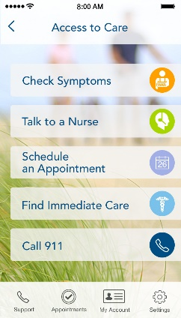
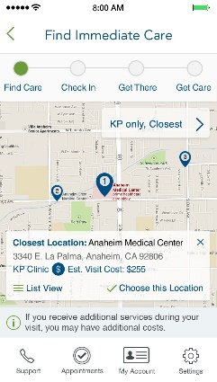
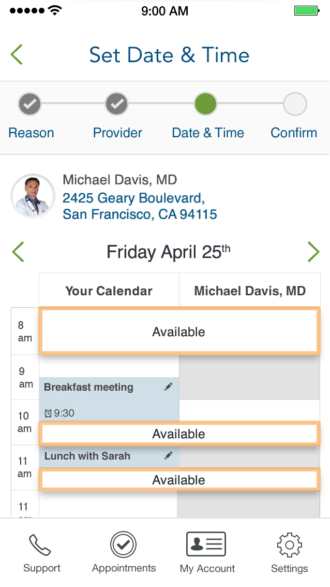
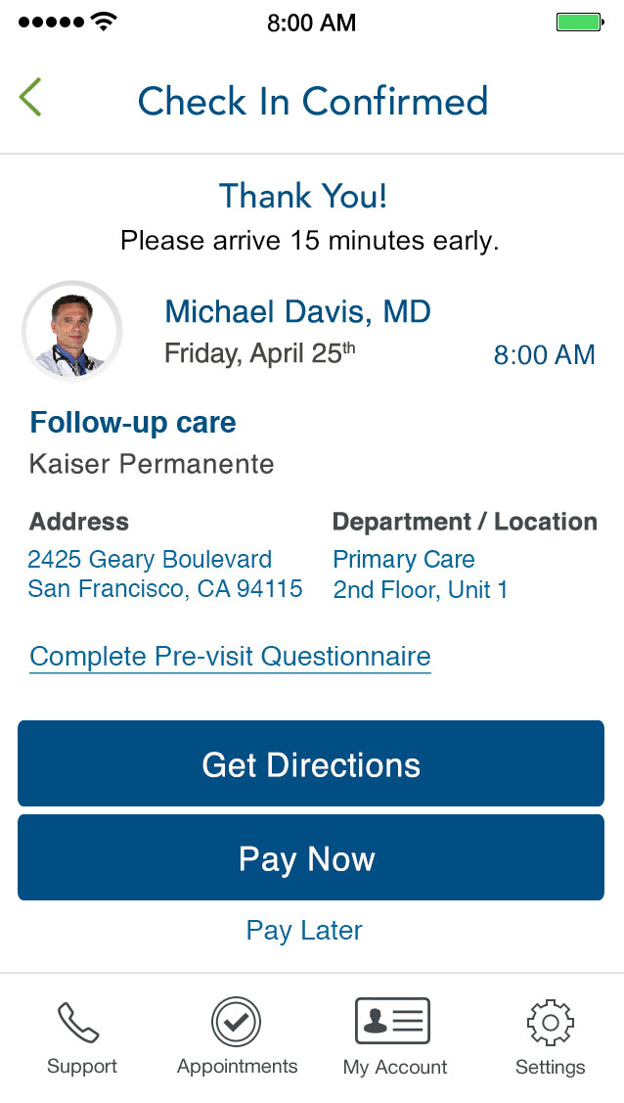
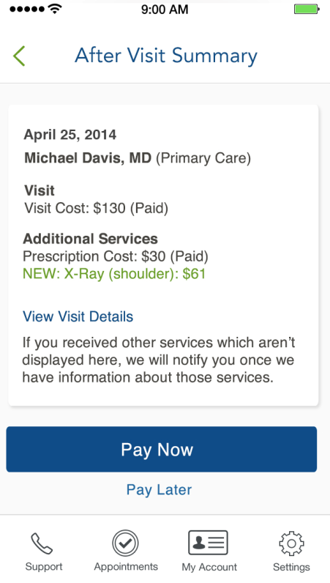
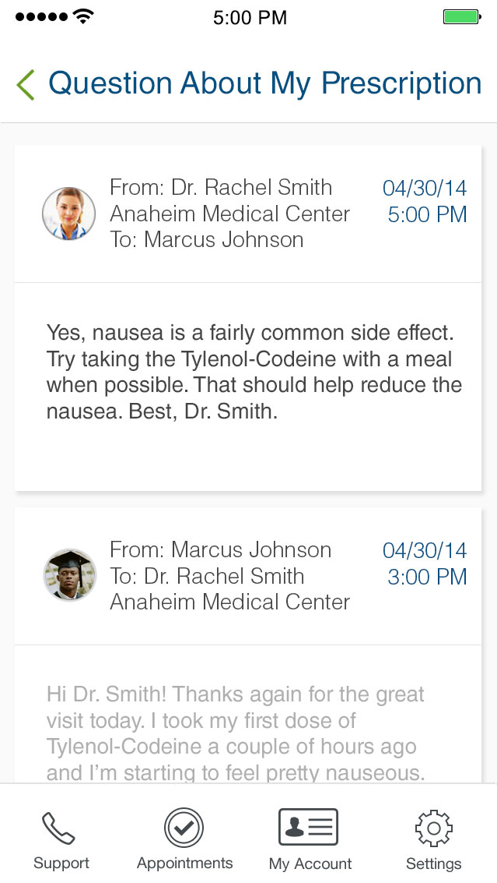
Delivering the Consumer Experience
“Digital Transformation is defined as the re-alignment of, or new investment in, technology and business models to more effectively engage digital consumers at every touchpoint in the customer experience lifecycle.”
Mobile first ● 9 months ● 9.3+ million members
My Appointments
Schedule an appointment
Talk to local call center
Talk to Advice Nurse
Find immediate care
Symptom Advisor
Find Immediate Care
Find closet facility
Search by KP, affiliate or non-KP facility
Sort by location
Sort by cost
Choosing a Date
Display physician photo
Integrated calendar view
Find time available for both physician and member
Choose a time
Pay Now
Display estimated cost
Display Accumulated Benefits
Credit card on file
Change payment method
Show progress bar
Contact financial assistance
Provide cost disclaimers
Complete online questionnaires
After Visit
After visit cost information
Post Visit Survey
Past visit information
Display pharmacy to pick up meds
Find and change pharmacy
Pay outstanding payments
Single View Messages
Single message box with email from all care team members across regions.
Including other communications like text messages, etc.
Policy & Process first ● 18+ months ● 9.3+ million members
Note, above was proposed scope presented June 2014 and we have not yet incorporated feedback provided.
Legend:
New feature
Enhancing existing feature
Release 1 Release 2 Release 3 Not in Scope
NOTE: Major features mapping reflect target release dates and may shift

Slide 5
Release 2 High-Level Scope
After Visit Hub | Financial Guidance | Find Care Extensions | Integrated Message Center | Coverage & Payments
New Production Features Delivered | New Production Features Delivered | Ongoing Foundation & Features from R1 | R3 Discovery & Foundation | R3 Discovery & Foundation
Enhanced “Past Appointment” screen organizing appt. details, default pharmacy, post visit survey, & financial support. Will scale in future releases to include additional features. | Tools empowering members to understand costs & benefits and make informed decisions | Past Providers list and discovery & foundational work necessary to deliver R3 integrated calendar sync, and time setting features. | Discovery and foundational work including profile & identity management work required to connect MRNs across regions | Discovery and foundational work including necessary entitlements to link member accounts to plan/benefits and necessary services to connect costs to care received
Post Visit Survey Display Pharmacy to Pick Up Meds Find & Change Pharmacy Past Visit Information | Contact Financial Assistance Complete Online Questionnaires | Schedule an Appointment Integrated Calendar View Find Time Available Choose a Time | Single Message Box with Email from Care Team Members Across Regions | After Visit Cost Information Pay Outstanding Payments Provide Cost Disclaimers Show Progress Bar

Slide 6
Release Highlights
Notes:
Speaker Notes (version 2.0)

Slide 7
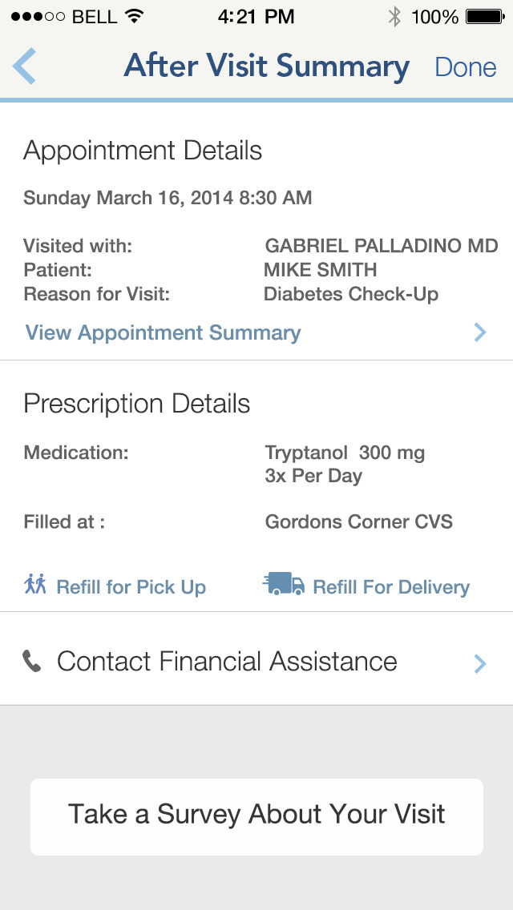










After Visit Appointment Hub Phase 1 (Release 2)
Consumer Experience
Accessed from the Past Appointments list, the After Visit Appointment Hub screens will elevate and unify the member experience by creating a streamlined, easy to use hub to access all after-visit information and actions pertaining to a specific past appointment, all in one place.
Value to Member
The After Visit Appointment Hub will empower the member to better understand the details of her appointment, necessary next steps, and her options for future care, services, or assistance.
Operational Value
By organizing and directing members to After Visit information and services, Kaiser Permanente can ensure members understand their care and receive necessary follow up, thus improving health outcomes. The AVAH will also drive engagement around key cost-saving initiatives like Mail Order Prescription Refills.
Acceleration Scope
Schedule an Appointment
Call Financial Assistance
Complete Questionnaires
Post-Visit Survey
Display Pick Up Pharmacy
Find & Change Pharmacy
Past Visit Information
Release 3 Scope
User Stories
US43935 Show Appointment Details on After Visit Appointment Hub Screen
US43876 Link to Post Visit Survey on After Visit Appointment Hub Screen
US43938 Add Contact Financial Assistance Link to After Visit Appointment Hub
US43987 Link to Refill Prescription by Pick Up in After Visit Appointment Hub
US43988 Link to Refill Prescription by Mail Order in After Visit Hub Screen
US43989 Link to Detailed Appointment Summary in After Visit A Hub Screen
US43990 Show Associated Prescriptions in After Visit Appointment Hub Screen
US43991 Show Associated Prescription Pharmacy for Pick Up in AVAHS

Slide 8
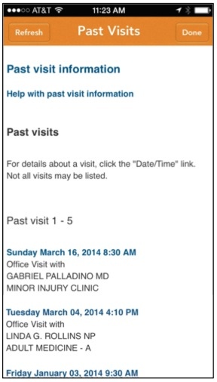
After Visit Appointment Hub Flow (Phase 1)
Backend Services

Slide 9
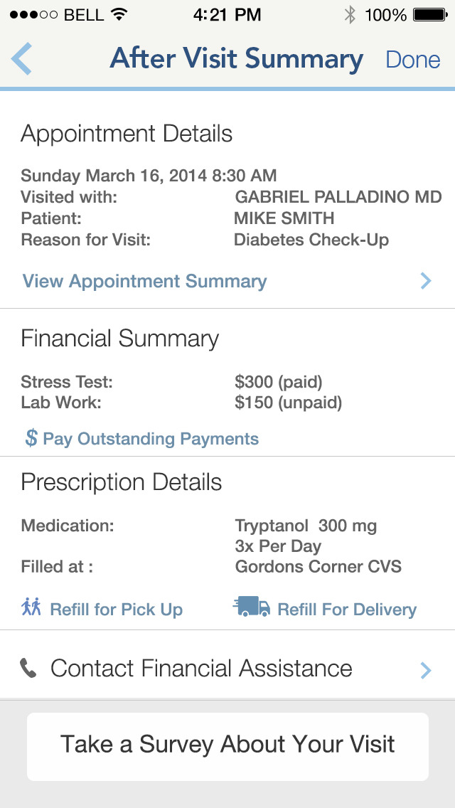
After Visit Appointment Hub Phase 2 (Release 3)
Consumer Experience
Phase 2 of the After Visit Appointment Hub will expand the hub to allow members to review a financial summary of all related appointment costs including copay, prescriptions, lab orders, and services received, along with the status (paid or due) of each item. Members will be able to pay outstanding payments directly from the AVAH.
Value to Member
Integration of financial summaries and mobile payments into the AVAH will increase member comprehension around the link between care and costs, and reduce existing pain points around receiving and paying bills.
Operational Value
By establishing a clear link between past appointments and related costs, Kaiser Permanente will facilitate member account management, increasing member affinity and retention. Driving engagement to mobile payments will likely result in more payments made overall.
Acceleration Scope
Schedule an Appointment
Call Financial Assistance
Complete Questionnaires
Post-Visit Survey
Display Pick Up Pharmacy
Find & Change Pharmacy
Past Visit Information
Release 3 Scope
User Stories
US43992 Show Appointment Services Received in After Visit Appointment Hub
US43993 Show Costs for Appointment Services in After Visit Appointment Hub
US43994 Show Payment Status for Appointment Services in After Visit Appointment Hub Screen
US43995 Link to Pay Outstanding Payments in After Visit Appointment Hub

Slide 10
After Visit Appointment Hub Flow (Phase 2)
Backend Services

Slide 11
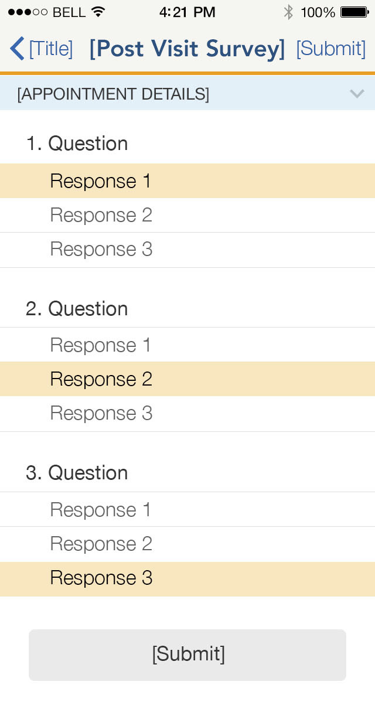
Complete Post-Visit Survey
Consumer Experience
After an appointment is over, members will be directed to complete a general, non-diagnosis specific survey to assess their understanding of the information presented to them and their overall experience during the visit. After the survey, members will be directed to KP tools and resources in which they could better their understanding.
In a future release, members could be directed to a specific post-visit survey for their outcome/diagnosis.
Value to Member
The Post-Visit survey will reinforce physicians’ lessons and recommendations and improve member comprehension & self-direction, increasing confidence and improving health.
Operational Value
The Post-Visit Survey will provide KP with data on member comprehension and appointment feedback, and will likely improve health outcomes by directing members to self-service tools & resources and ensuring comprehension.
Acceleration Scope
Schedule an Appointment
Call Financial Assistance
Complete Questionnaires
Post-Visit Survey
Display Pick Up Pharmacy
Find & Change Pharmacy
Past Visit Information
Release 3 Scope
User Stories
US44001: Build Native Post-Visit Survey Tool
US44002: Link to Tap-To Call Advice Nurse on Post-Visit Survey Results Screen
US44003: Link to KP Health Encyclopedia on the Post-Visit Survey Results
US44004: Link to Tap-To-Call Appointment Facility on the Post-Visit Survey Results Screen

Slide 12
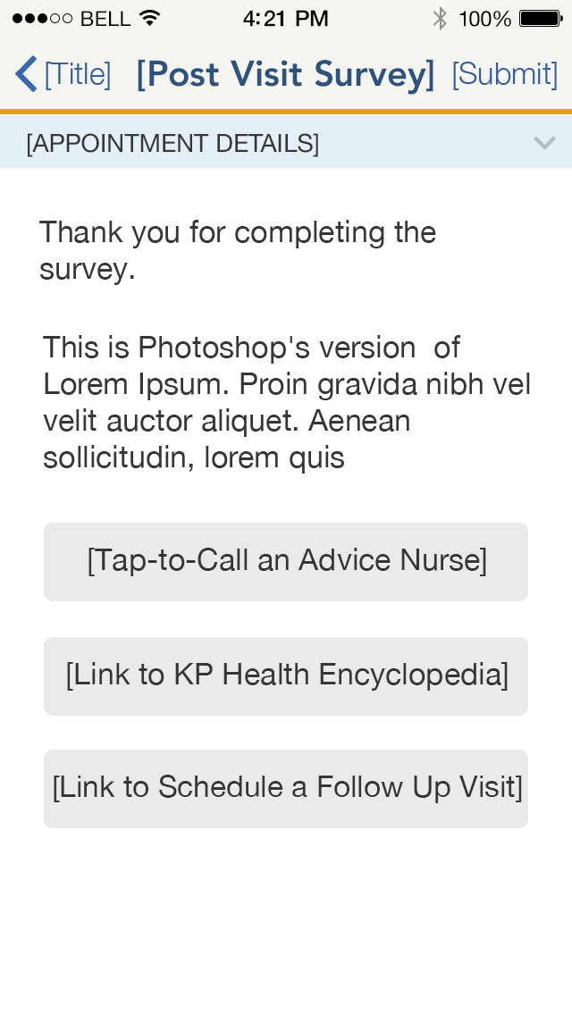
Post Visit Survey Flow

Slide 13
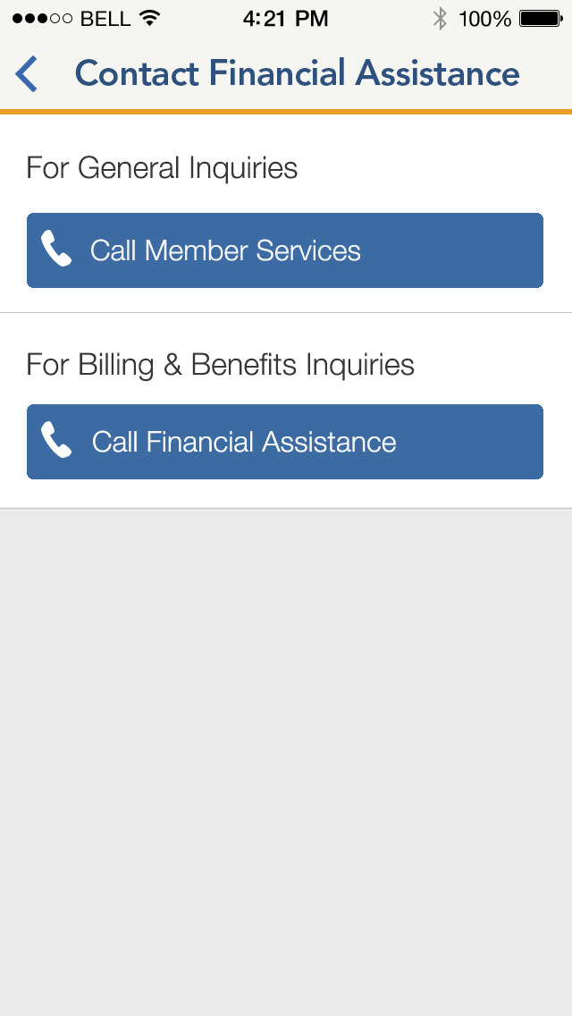
Contact Financial Assistance
Consumer Experience
Members will be directed to contact the financial assistance call center within Member Services both from the Flyout menu (for quick access anytime) and contextually when members might need need more information about costs or benefits before deciding to accept care or services (ie. scheduling an appointment.)
Value to Member
Driving members to the financial assistance call center, especially contextually from within relevant flows, will minimize financial surprises, increase member comprehension of costs and benefits, and empower members to make informed decisions and plan for care.
Operational Value
Increased member comprehension and informed decision-making will reduce inquiries and complaints following receipt of bills & will likely increase total payments made.
Acceleration Scope
Schedule an Appointment
Call Financial Assistance
Complete Questionnaires
Post-Visit Survey
Display Pick Up Pharmacy
Find & Change Pharmacy
Past Visit Information
Release 3 Scope
User Stories
US43919: Add ‘Contact Financial Support’ to Flyout Menu
US43920: Add Tap-To-Call Financial Assistance to Appointment Scheduling “Review & Book” Screen

Slide 14
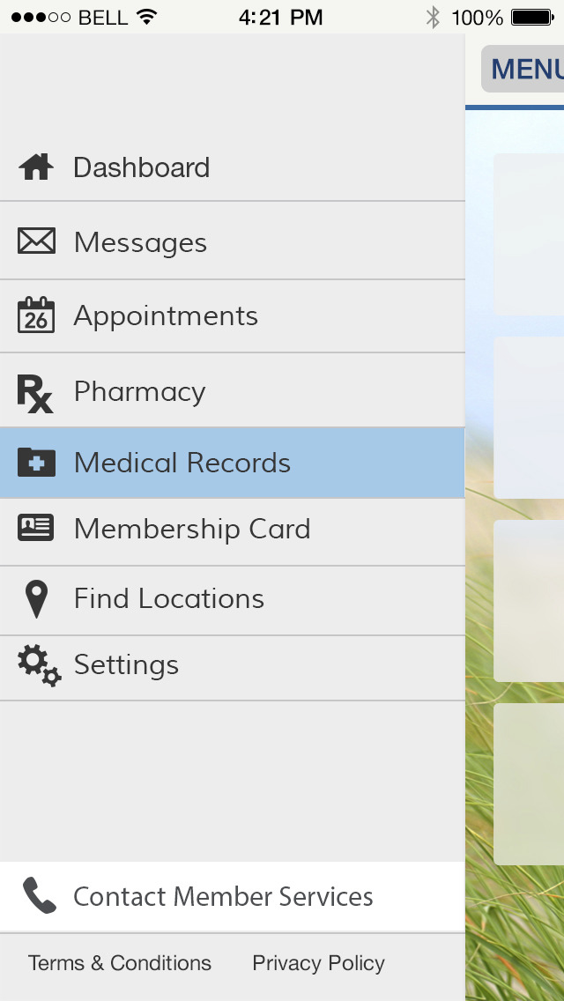
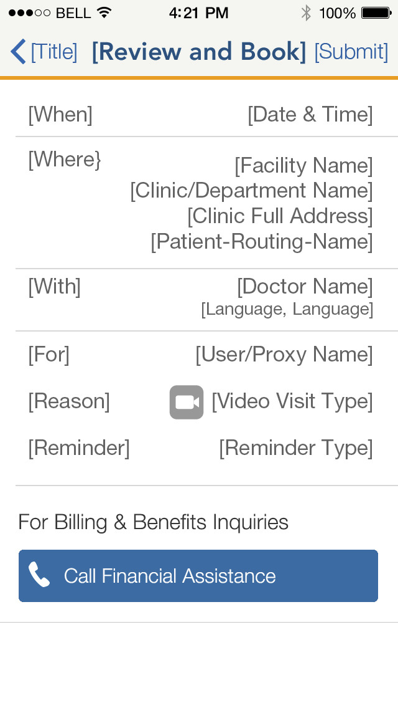
Contact Financial Assistance Flows
Flyout Menu
Appointment Scheduling:
Review & Book
Contact Kaiser Permanente

Slide 15
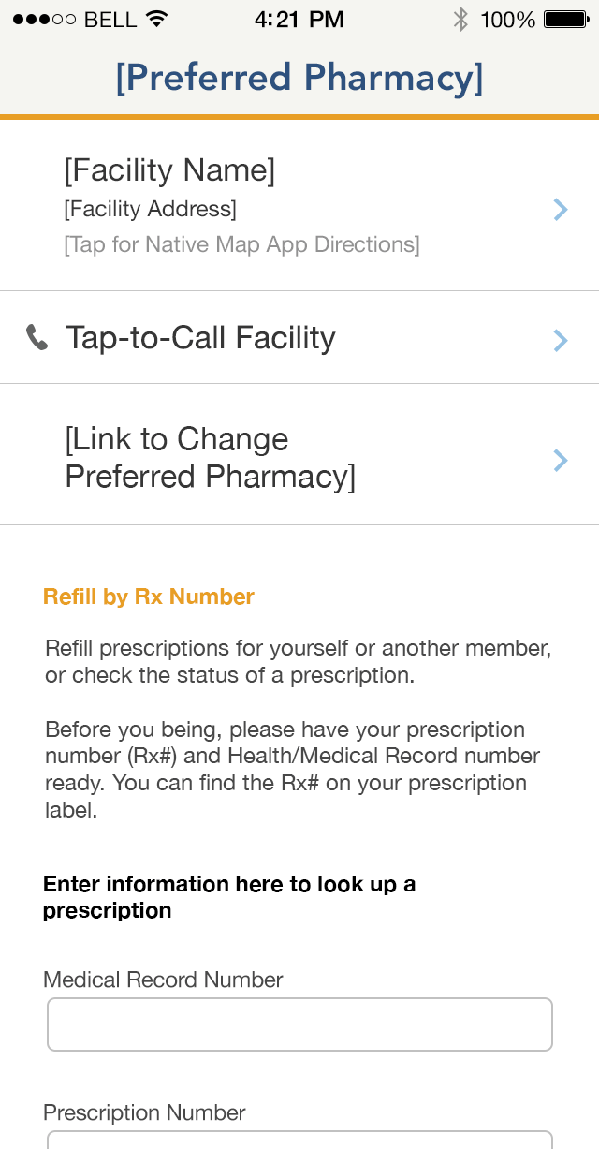
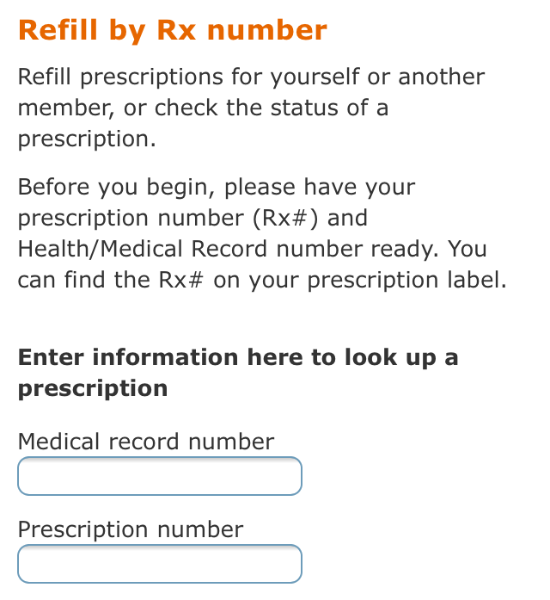
View & Manage Pharmacy For Prescription Pick Up
Consumer Experience
Members will be able to set a default (“preferred”) pharmacy for prescription pick up. This preference will be communicated to the prescribing physician and will be shown in the After-Visit Appointment Hub to ensure members know where to go to pick up.
For refills, members will be able to refill from the same pharmacy, change pharmacy, or refill by mail order.
Value to Member
Setting a preferred pharmacy will streamline the after-visit experience and minimize confusion to ensure members can pick up prescriptions quickly and easily.
Operational Value
Enabling members to set a preferred pharmacy for prescription pick up will minimize post-visit confusion and decrease the number prescriptions that are not claimed. Prioritization of the option to refill by mail will increase awareness and drive adoption to this cost-saving practice.
Acceleration Scope
Preferred Pharmacy
Schedule an Appointment
Call Financial Assistance
Complete Questionnaires
Post-Visit Survey
Display Pick Up Pharmacy
Find & Change Pharmacy
Past Visit Information
Release 3 Scope
Facility Name
Facility Address
[Tap for Native Map App Directions]
Tap-to-Call Facility
Link to Change Preferred Pharmacy
User Stories
US43921 Link to Set Default Pharmacy for Prescription Pick Up in “Prescriptions” Section
US43922 Set Facility as Default Pharmacy in “Find Locations” tool
US43928 Show User Default Pharmacy in “Prescriptions” Section
US43929 Change Default Pharmacy in “Prescriptions” Section
US43986 Communicate Member Pharmacy Preference to Physicians

Slide 16
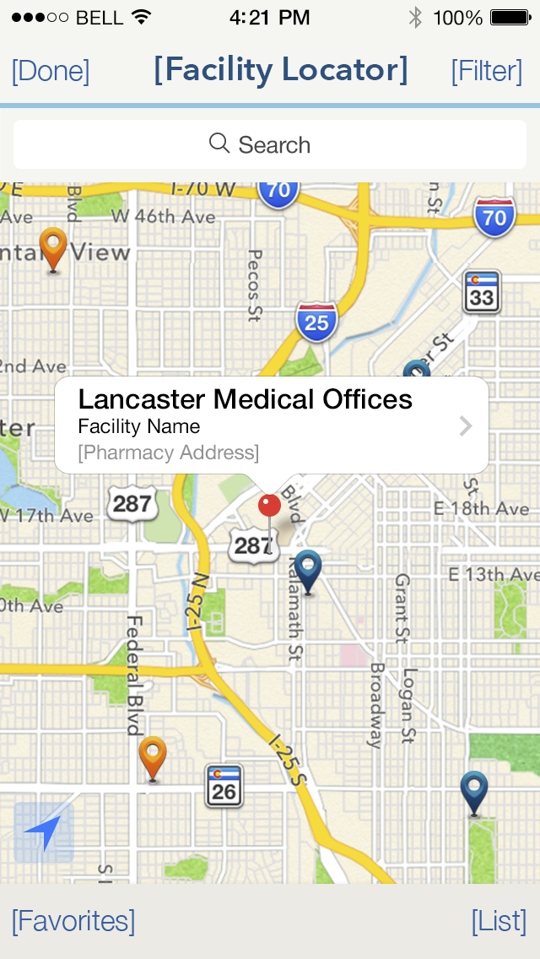
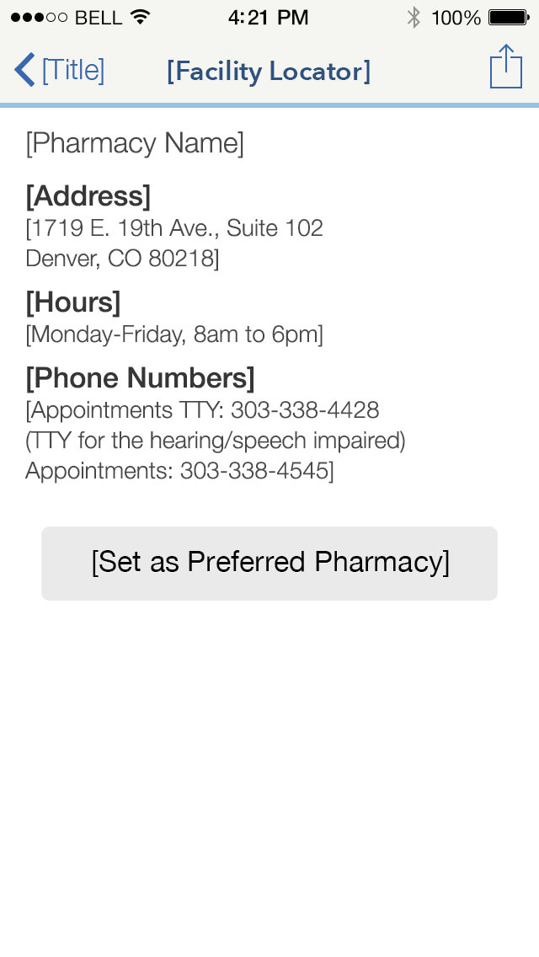
View & Manage Pharmacy Flow

Slide 17
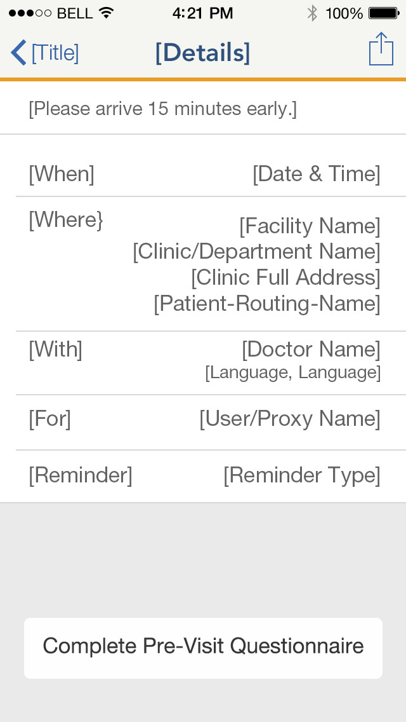
Complete Pre-Visit Insurance Questionnaires
Consumer Experience
From the Upcoming Appointments list, the member will be able to complete a pre-visit insurance questionnaire (where required) to streamline the pre-appointment financial process.
After the member completes the pre-visit questionnaire, she will be given the option to call Financial Assistance in case she has any other costs or benefits questions to settle before she arrives at the appointment.
Value to Member
Pre-Visit Insurance Questionnaires streamline the member’s pre-visit process and ensure that when she arrives at her appointment she can focus on the care itself. Members will have a bolstered understanding of their costs and benefits and after-visit pain points around billing and pain points will be reduced.
Operational Value
By empowering members to quickly and easily complete pre-visit questionnaires, Kaiser Permanente will drive completion of the questionnaires and receive a higher number of responses, enabling increased personalization for members and facilitating a seamless after-visit process.
Acceleration Scope
Schedule an Appointment
Call Financial Assistance
Complete Questionnaires
Post-Visit Survey
Display Pick Up Pharmacy
Find & Change Pharmacy
Past Visit Information
Release 3 Scope
User Stories
US44000 Link to Complete Pre-Visit Insurance Questionnaires from “Upcoming Appointments” List

Slide 18
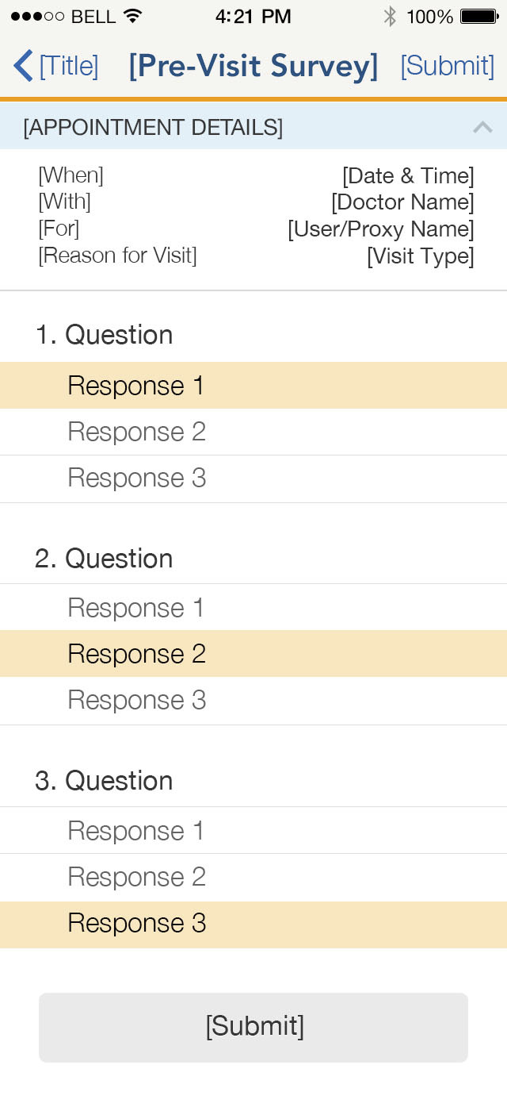
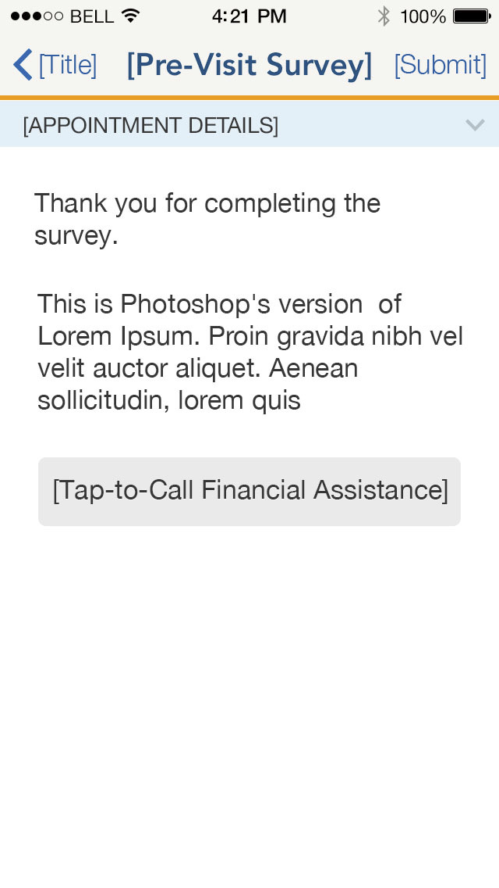
Complete Pre-Visit Insurance Questionnaire Flow

Slide 19
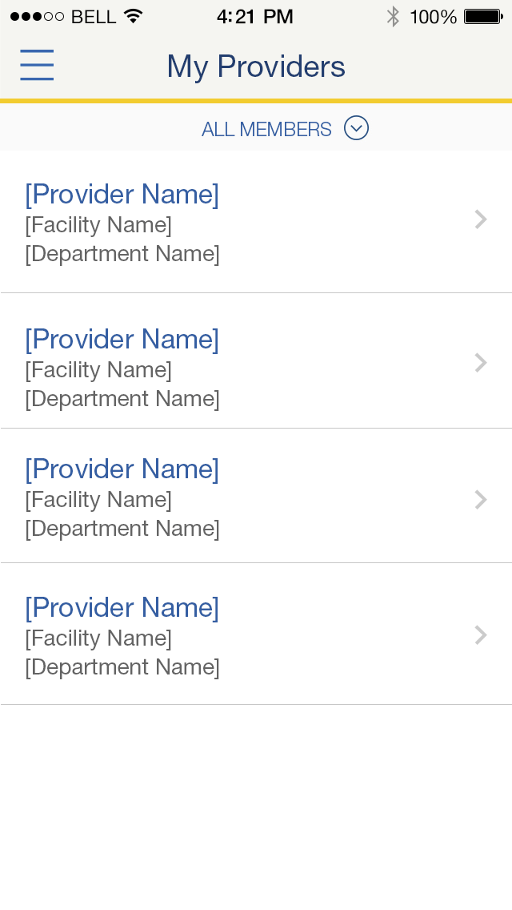
Past Providers List
Consumer Experience
From a new menu option, members will access a list of all providers they have seen in the past, including facility name and contact information.
Value to Member
Members will have quick access to providers they’ve seen in the past, and will have an improved, comprehensive understanding of their care team and a stronger relationship to their providers.
In a future release, members will be able to schedule an appointment with a past provider directly from this list.
Operational Value
In facilitating doctor/patient interactions, the My Providers list will contribute to a more seamless care experience and will be a first step to future-state digital model that bolsters a member’s relationships with her Care Team and increases self-service options for care.
Acceleration Scope
Schedule an Appointment
Call Financial Assistance
Complete Questionnaires
Post-Visit Survey
Display Pick Up Pharmacy
Find & Change Pharmacy
Past Visit Information
Release 3 Scope
User Stories
US43387 View List of Past Providers
US43649 Past Providers – Flyout Menu Dropdown

Slide 20
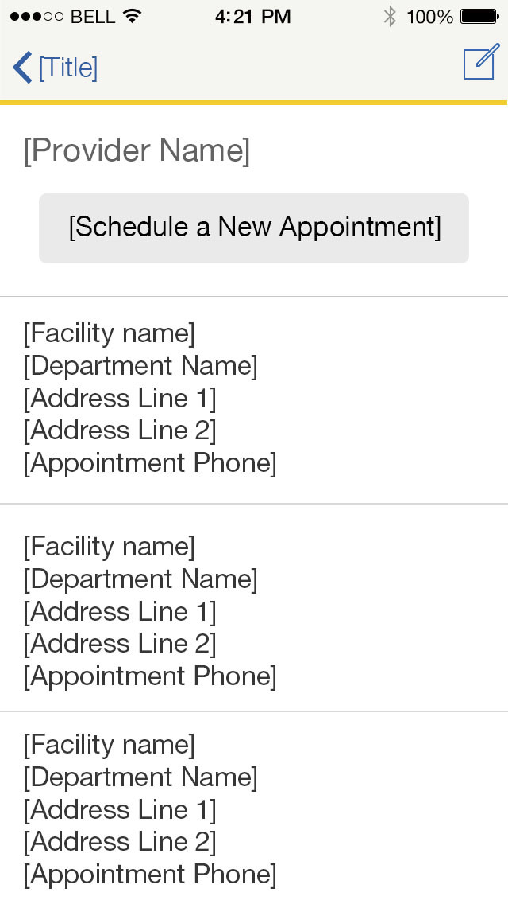
Past Providers List Enhancements
Consumer Experience
From the detail view for a member’s past provider, he will be able to quickly schedule a new appointment with this provider. By tapping ‘Schedule a New Appointment’ the member will be taken to the relevant appointment scheduling flow, picking up at the next step after selecting a provider. Past provider photos will be shown, and the member will be able to filter between his providers and his proxies’, increasing usability and encourage reuse.
Value to Member
Past Provider list enhancements will streamline the appointment scheduling process and personalize the member experience with a clear link to his care team.
Operational Value
Empowering members to schedule a new appointment directly from the past providers list will drive members to revisit past providers, thus strengthening relationship between Kaiser Permanente providers and members. Bolstered member comfort and stronger care relationships will likely increase member appointments and improve health outcomes.
Acceleration Scope
Schedule an Appointment
Call Financial Assistance
Complete Questionnaires
Post-Visit Survey
Display Pick Up Pharmacy
Find & Change Pharmacy
Past Visit Information
Release 3 Scope
User Stories
US43386: Link to Schedule a New Appointment from Past Providers List
US43392: Filter Past Providers List by Proxy
US43910: Display Physician Photo in Past Providers List

Slide 21
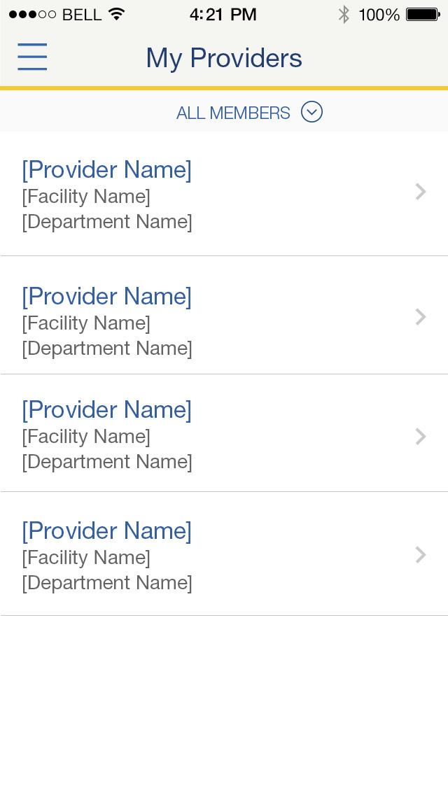
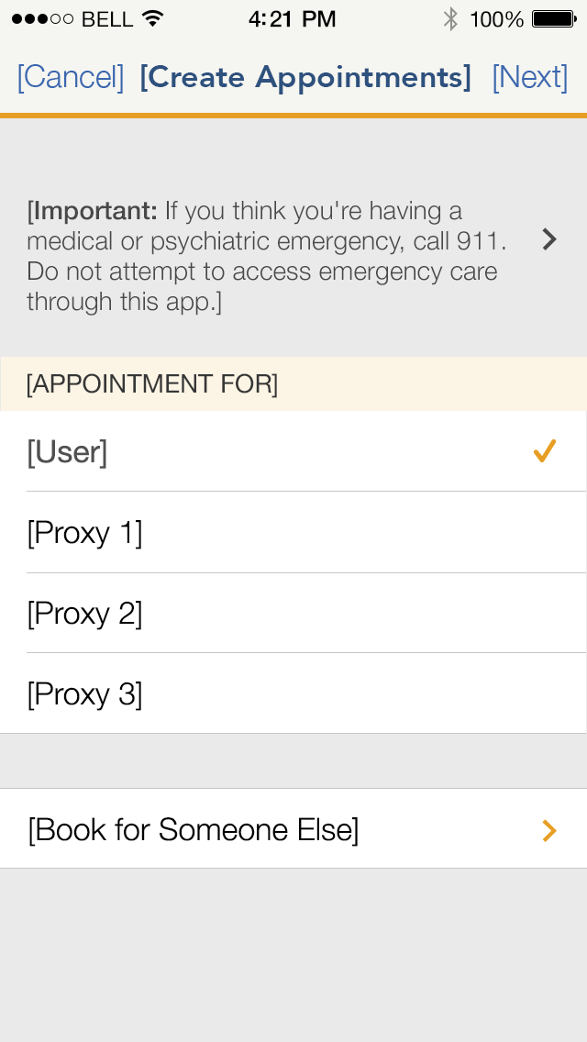
Schedule an Appointment with Past Provider Flow

Slide 22
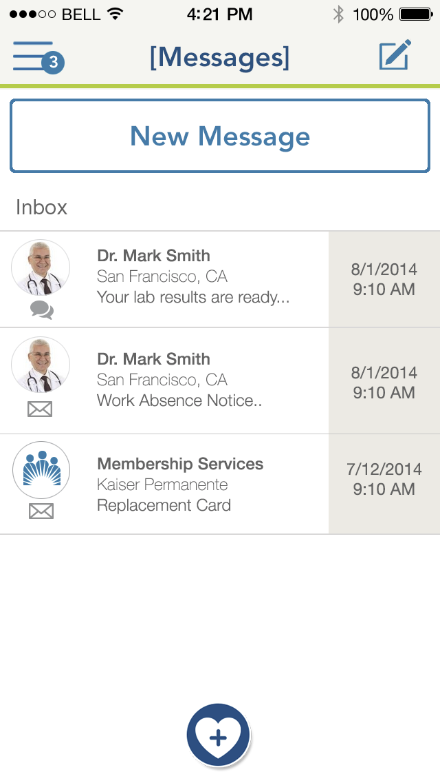
Integrated Message Center (R3) Discovery & Foundation
Consumer Experience
In the Integrated Message Center, a member will be able to send and receive message to Member Services and all physicians they’ve seen, inside or outside of their home region for all locations. The Integrated Message Center will support document attachment, including forms members can complete within the app.
Value to Member
The Integrated Message Center will provide an easy, seamless way for members to communicate with all of Kaiser Permanente and organize all of their important documents and correspondence in one place.
Members who receive care with Kaiser Permanente outside their home region will be able to contact these non-home region providers with follow up questions.
Operational Value
Enhancements to create an Integrated Message Center are crucial to the mission of One KP: providing members and providers a seamless experience by enabling cross-region communication and unification of a single, highly usable digital toolkit.
Acceleration Scope
Schedule an Appointment
Call Financial Assistance
Complete Questionnaires
Post-Visit Survey
Display Pick Up Pharmacy
Find & Change Pharmacy
Past Visit Information
Release 3 Scope
User Stories
US43871: Digital Identity Management Work Supporting Single Message Box
US43870: [R3} [EPIC] Single Message Box with Email from All Care Team Members Across Regions

Slide 23
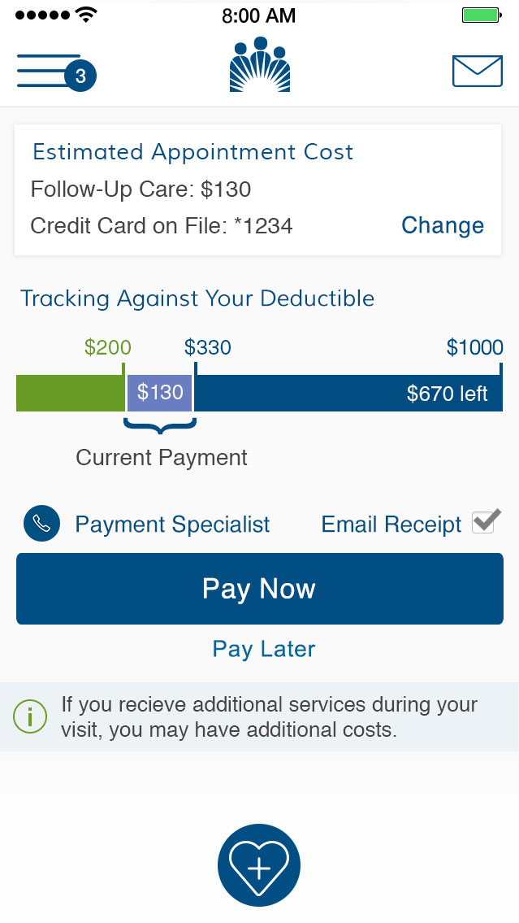
Pay Now (R3) Discovery & Foundation
Consumer Experience
For relevant appointments, members will be able to quickly and easily pay in advance for estimated future appointment costs (ie. copays), using a payment method stored in the app. Members will receive cost disclaimer messaging informing them of potential added costs, and will be able to keep up with progress on their deductible with the accumulation tracking visualization.
Value to Member
Mobile payments will transform the consumer financial experience, streamlining the appointment process and minimizing known pain points around cost and benefit comprehension. By pre-paying, members will be able to arrive at an appointment and focus on care, not payments.
Operational Value
Kaiser Permanente’s transformed consumer financial experience will drive retention and reuse by making it easy for members to manage their account and payments, and will increase total payments received while reducing the number of billing questions and complaints received.
Acceleration Scope
Schedule an Appointment
Call Financial Assistance
Complete Questionnaires
Post-Visit Survey
Display Pick Up Pharmacy
Find & Change Pharmacy
Past Visit Information
Release 3 Scope
User Stories
US43918: [R3] [EPIC] Deductible Tracking Progress Bar
US43917: [R3] [EPIC] Provide Cost Disclaimers
US43916: Add a Credit Card on File
US44006: Change Payment Method

